Slide 1
RDBMS MINI PROJECT TEXTILE SHOP MANAGEMENT SYSTEM
PRESENTED BY:
SWETHA B (187199)

Slide 2
TABLE OF CONTENTS
OBJECTIVE
ABSTRACT
SOFTWARE REQUIREMENTS
DESIGN PHASE
->TABLES USED
->ER DIAGRAM
DEVELOPMENT PHASE
->TOPICS USED FOR CODING
TESTING
->TEST CASES

Slide 3
OBJECTIVE
Designing the database and understand the basic concept of database
management system for the textile shop management system using SQL and PLSQL concepts.

Slide 4
ABSTRACT
This database is used as Textile shop management system for managing the details of the purchase made in the textile shop.
This database also contains some procedures and functions of the textile shop purchase and some stock details.

Slide 5
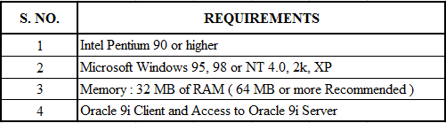
SOFTWARE REQUIREMENTS

Slide 6
DESIGN PHASE
Tables used
ER diagram

Slide 7
TABLES USED
PURCHASE_ITEM_DETAILS
Bill_id (foreign key)
Item_id (foreign key)
Price
Tax
Amount
Worker Department
Dept_id (Primary Key)
Dept_name
ITEM_DETAILS
Item_id primary key
Item_category_id (Fk)
Price
ITEM_CATEGORIES
Item_category_id Primary key
Item_name
Item_type
Item_colour
Price
Brand
Item_size
WORKER
Worker_id (Primary key)
Worker_name
Dob
Gender
Address
Age
Mobile no
Dept_id
Section
Salary
STOCK_DETAILS
Item_category_id
Total_Quantity
Purchase_qty
Balance_qty
CUSTOMER
Bill_id ( Primary key)
Date_of_purchase
Customer_name
Mobile_no
Mode_of_payment
Total_amount

Slide 8
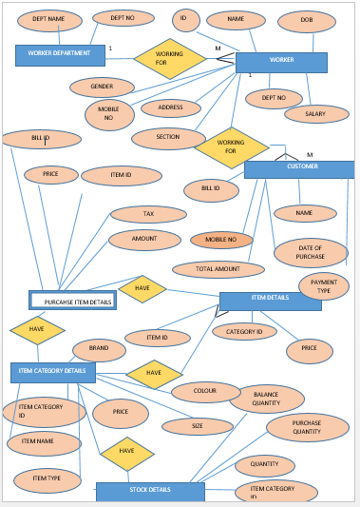
ER DIAGRAM

Slide 9
DEVELOPMENT PHASE
TOPICS USED FOR CODING
CODING
QUERY SNAPSHOTS

Slide 10
TOPICS USED FOR CODING
SQL -DDL,DML,DCL,TCL
SQL -JOINS AND SUBQUERIES
PLSQL -PROCEDURES AND FUNCTIONS
PLSQL -TRIGGERS
PLSQL -EXCEPTION HANDLING
PLSQL -CURSORS

Slide 11
DEVELOPMENT PHASE
CODING:
In this coding phase, the operations of all the data is managed and all other SQL queries
are performed.
The computer programs writing, testing and debugging is also performed in this phase.

Slide 12
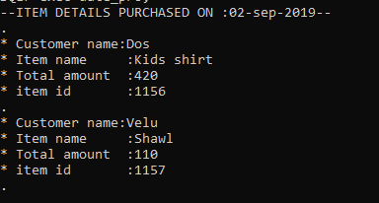
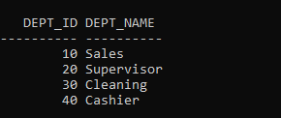
QUERY SNAPSHOTS

Slide 13
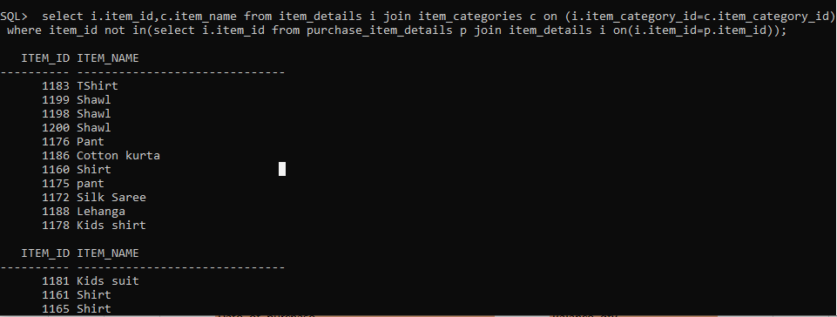
QUERY SNAP SHOTS Query to give the item details which are not sold

Slide 14
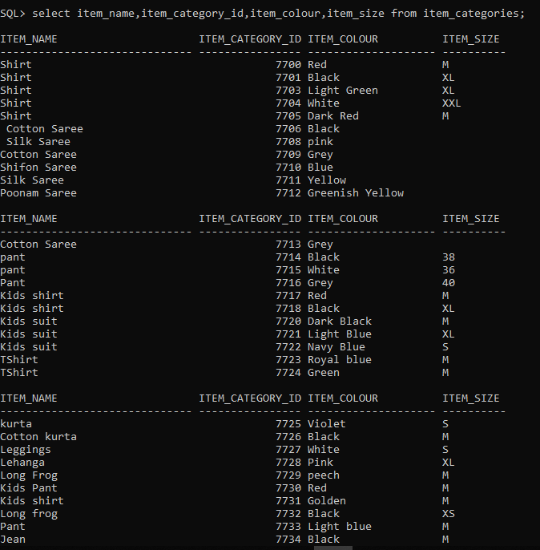
Query to display the item details:

Slide 15
TESTING PHASE
TESTING SUMMARY
Total No. of test cases : 2
No. of test cases passed :1
No. of test cases passed giving exception :1

Slide 16
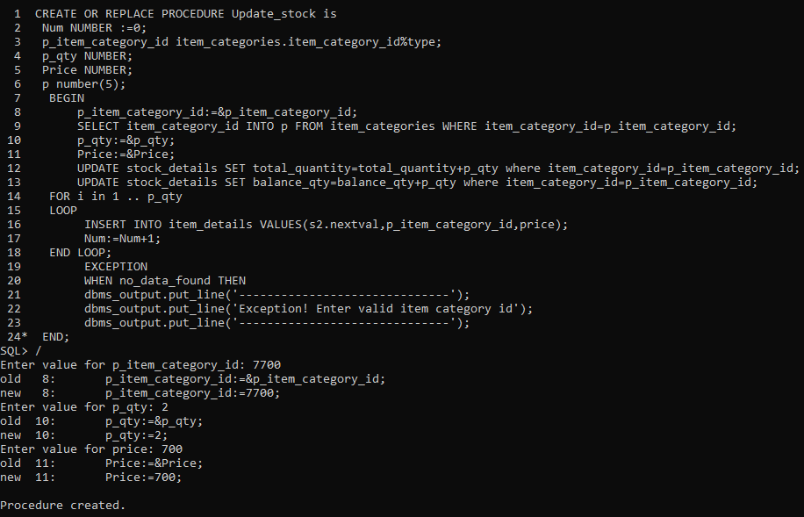
TESTING PHASE
* Purchased item details for a given bill id

Slide 17
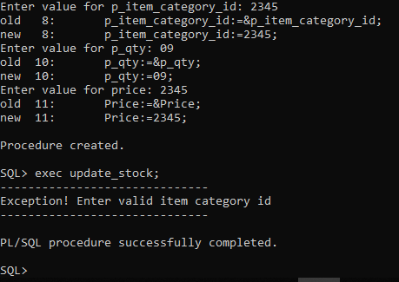
EXCEPTION HANDLING
Exception was raised when we gave invalid id of item category

Slide 18
THANK YOU

